Slide 1

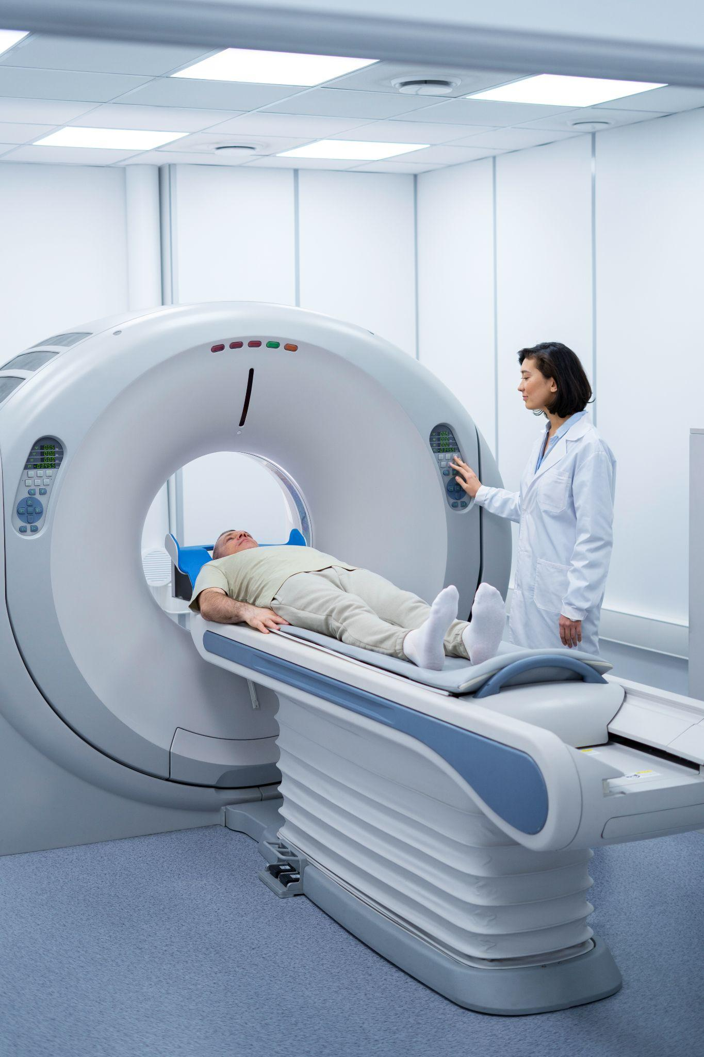
Team B: Automating Radiation Errors Detection
Laylani Callaway, Casey Devine,Tyler March, Jasper Sylvestre, Lucy Liu
Notes:
Laylani

Slide 2
Table of Contents
01
02
03
04
05
Background Info
Data Description
Data Cleaning
Modeling
Future Steps
Notes:
Laylani

Slide 3
Background Info: Radiation Errors
Medical errors can occur in various forms
Some are worse than others
Too often resulting in death
Especially risky for those in critical condition
Radiation therapy is used for about half of cancer patients
The complex process involving different systems, medical personnel, and devices make this field prone to error
We want to standardize the reporting of these errors by using NLP and modeling
Notes:
Jasper

Slide 4

Data Description
Data collected by USLCC and provided to us by RadPhysics Services LLC as part of the Medical Error Reduction Program (MERP)
Database containing deviation events that occurred during the radiotherapy process
Information includes a free text description of the deviation as well as a few extra variables (date identified, identifier id, etc.)
Notes:
Tyler

Slide 5
Response
Pre/Post
Subcategory
0-11-22222-33333
Category
Attribute
Notes:
Laylani

Slide 6
Data Cleaning Stage
Removed all observations that did not contain data
Broke error code down into 4 parts (Pre/Post, Category, Subcategory, Attribute)
Created new Broad Category variable
As described in “Automated Error Labeling in Radiation Oncology via Statistical Natural Language Processing”
Cleaned text data
Combined relevant data from different files into one dataset
Notes:
Tyler

Slide 7
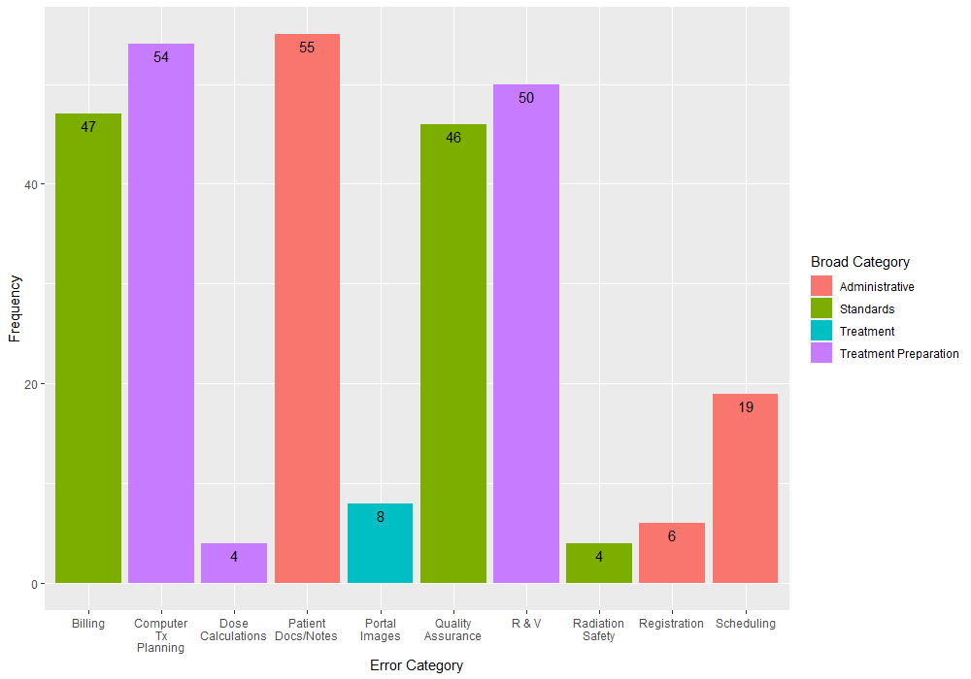
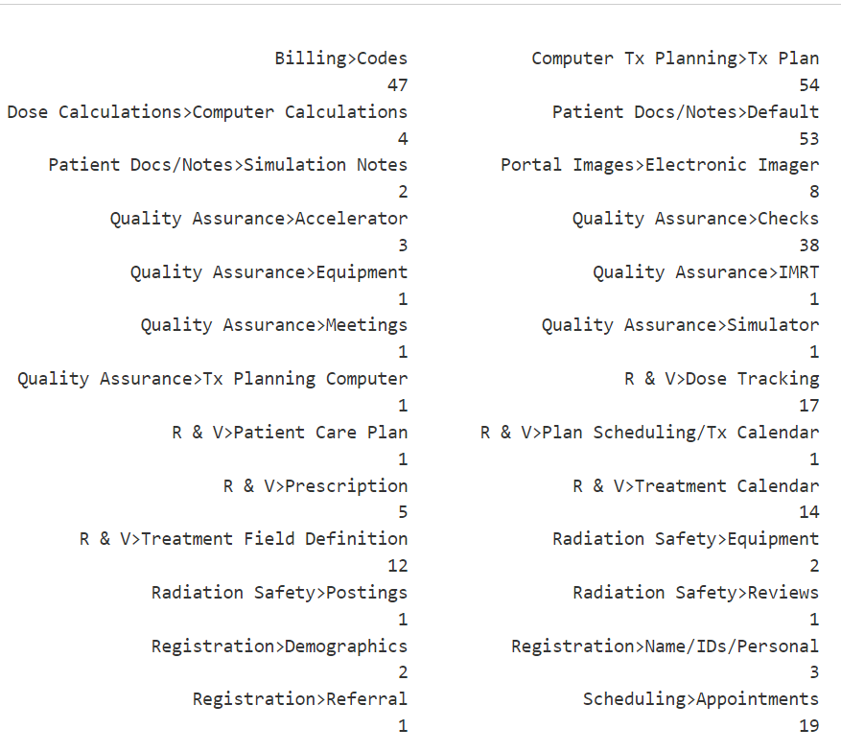
Data Cleaning: Challenges Encountered
Members with different approaches
Difficulty understanding the explanatory variables and response variables
Notes:
Tyler

Slide 8
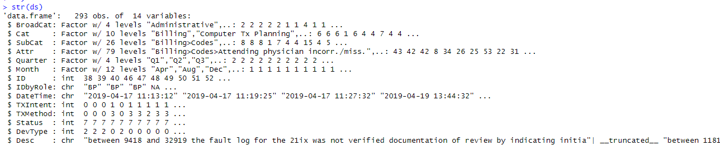
Data Cleaning: Outcome
Notes:
Laylani

Slide 9
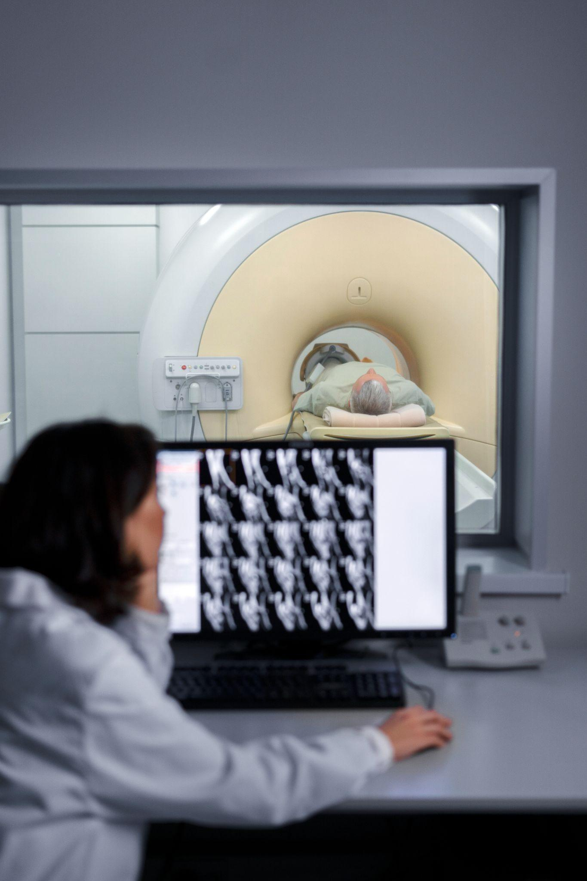
Exploratory Data Analysis

Slide 10
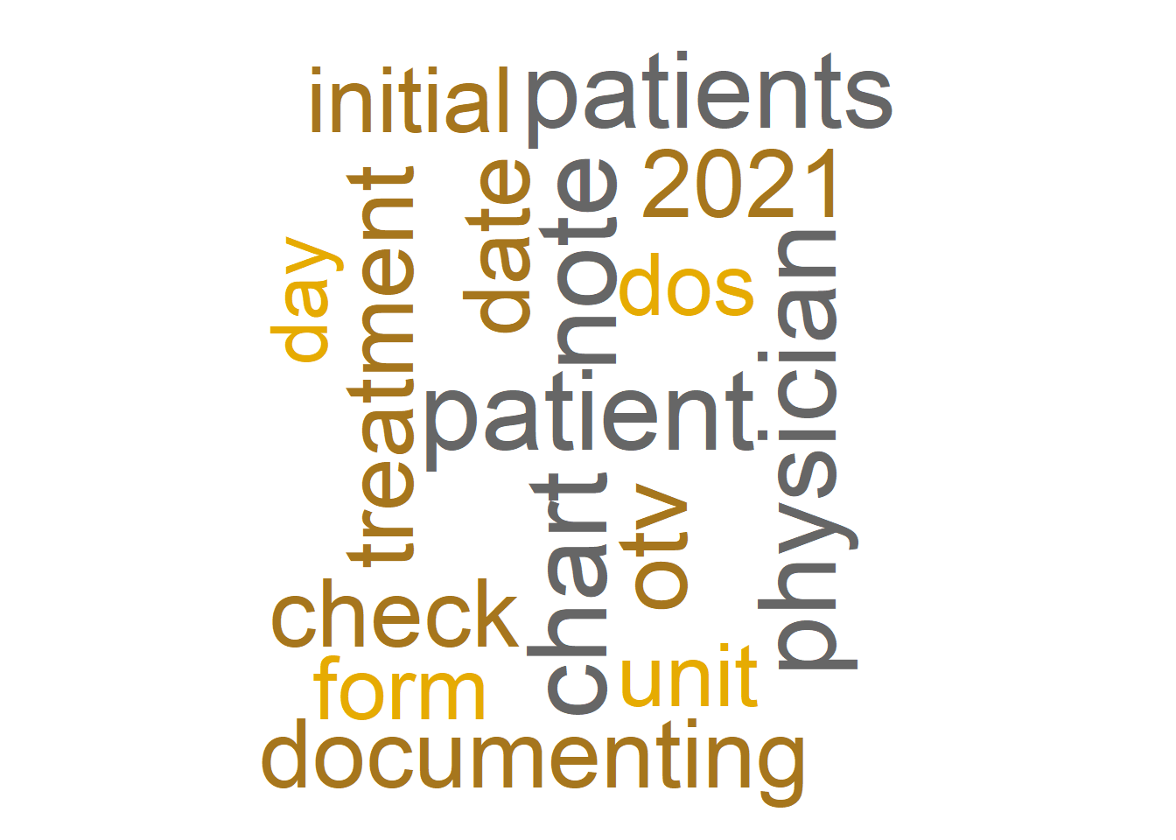
Text Analysis
Lowercased and stripped punctuation from free text description
Used LSA to examine how words occur or co-occur with each other
Word map shows most occurring words from text analysis
Notes:
Casey

Slide 11
Modeling
Modeling was broken up by group member as follows:
Multinomial Logistic Regression
Casey
Discriminant Analysis and Naive Bayes
Laylani
SVM
Tyler
k-NN
Lucy
Random Forests
Jasper
Notes:
Casey

Slide 12
Modeling: Challenges Encountered
Working with LSA
Modeling with QDA
Modeling with Multinomial Logistic Regression
Proper cross validation when using LSA
Getting good classification error rates
Notes:
Casey

Slide 13
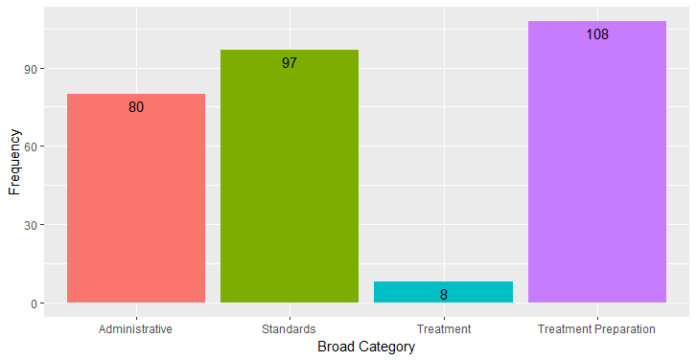
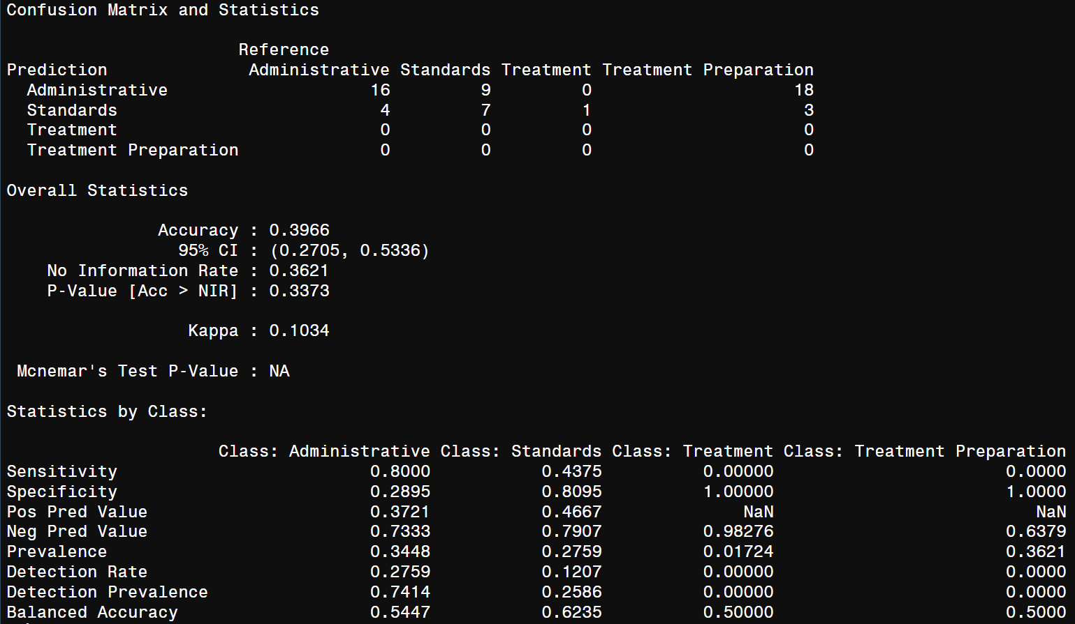

Modeling: SVM
Training Proportion: 0.8
Testing Proportion: 0.2
K = 10 iterations

Slide 14

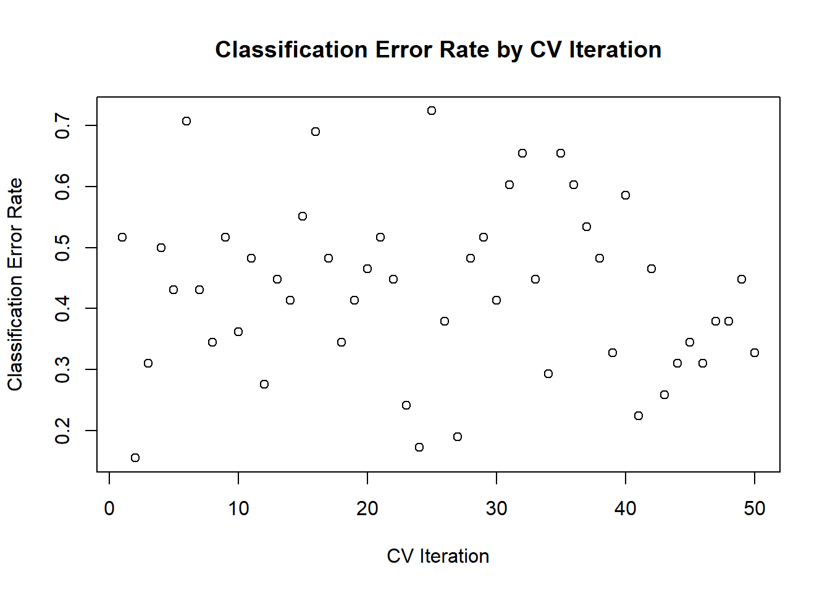
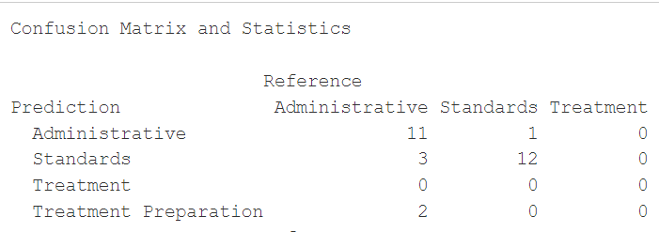
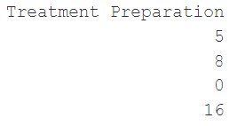
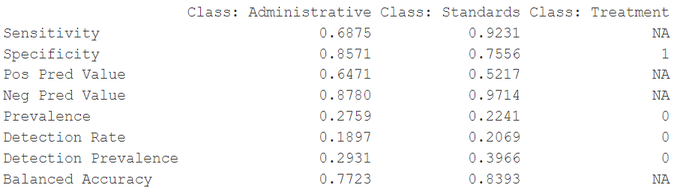
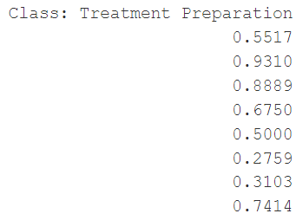
SVM
Training Proportion: 0.8
Testing Proportion: 0.2
K = 50 iterations
Sparsity Cap of 0.8 using removeSparseTerms()

Slide 15
Modeling: Discriminant Analysis
There was an issue with the grouping when attempting to use QDA.
LDA also didn’t yield very useful results when the text analysis was included.
Interestingly, the LDA model not using the LSA text matrix had a 29.4% error rate.
Notes:
TXIntent: User is asked the following regarding the treatment intent: 0 = NA, 1 = Curative, 2 = Palliative (pain relief only).
TXMethod: User is asked what kind of treatment method is being utilized: 0 = NA, 1 = Conventional EBRT, 2 = 3D-CRT, 3 = IMRT, 4 = SRS, 5 = SBRT.
Status: Ranges from 7 to 10.
DevType: Main type of deviation selected by the user on the first screen when entering an error: 0 = Clinical, 1 = Radiation Safety, 2 = Quality Assurance.

Slide 16
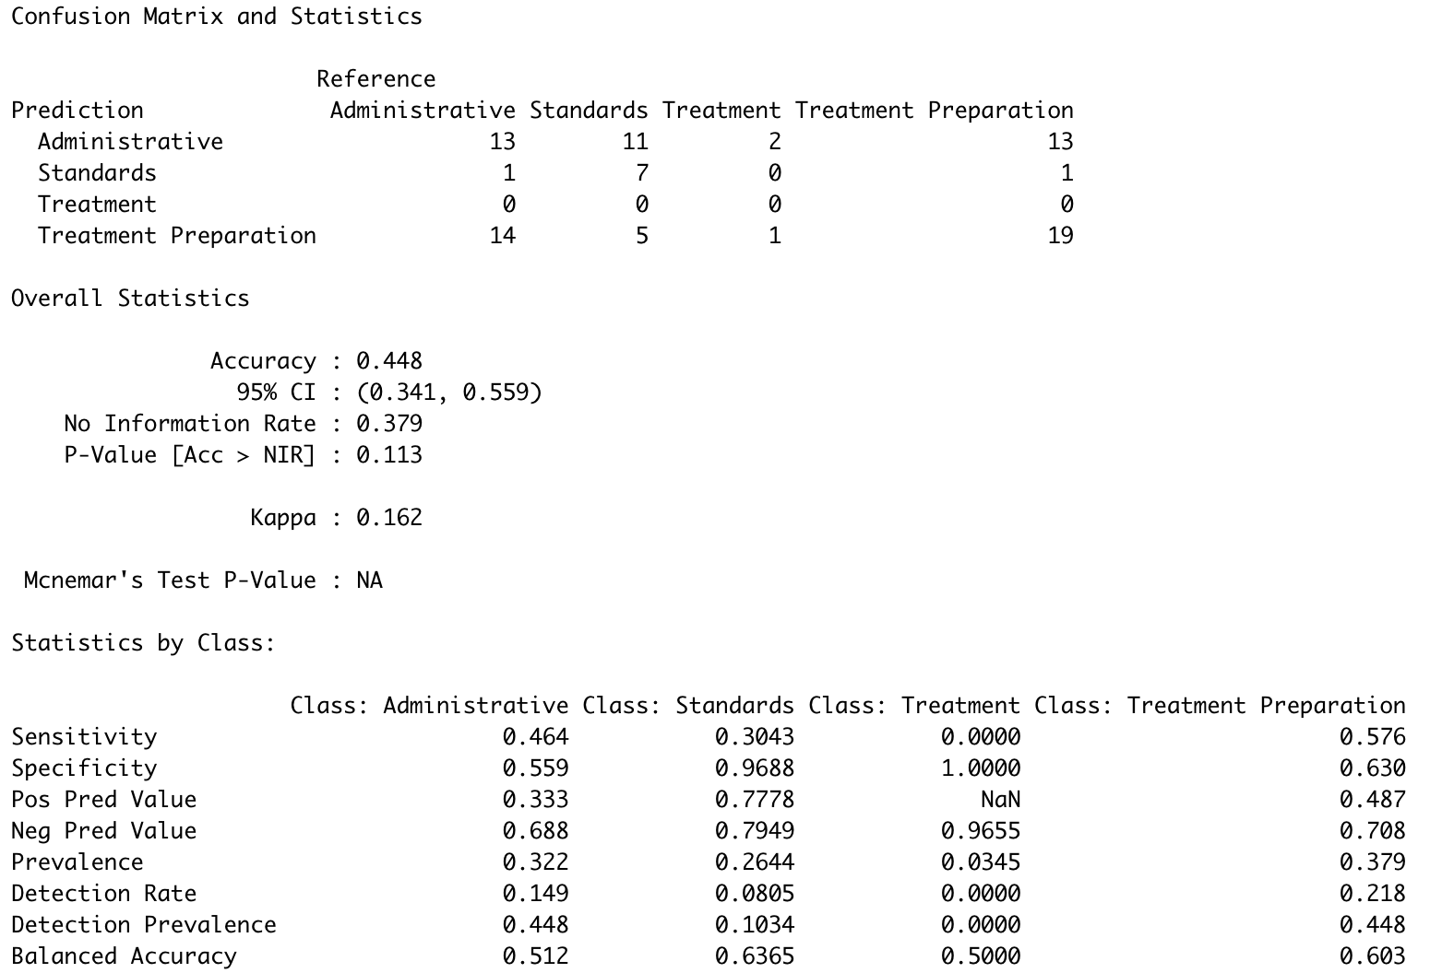
Modeling: Naive Bayes
Classification Error: 55.2%
Accuracy: 44.8%
K = 50, 70% training data
Again the model ignoring the predictor using the text had a smaller error rate (33.8%).

Slide 17
Modeling: Random Forest
Model with LSA data
Model without LSA data
Results from k = 10 cross-validation, 70% training / 30% testing, and 500 trees
Modeling Broad Category
With LSA, there are 66 predictors, so m = 9
Without LSA, there are 9 predictors, so m = 3
Results seems counterintuitive
Potentially further investigation should be done into the LSA, including principal component analysis
Notes:
Jasper

Slide 18
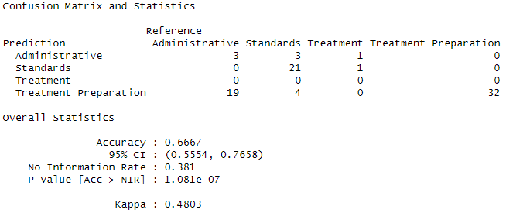

Modeling: Random Forest (Continued)
Model with LSA data
Model without LSA data
Notice the model with LSA data never predicts any Treatment errors while the model without LSA data does
Notes:
Jasper

Slide 19
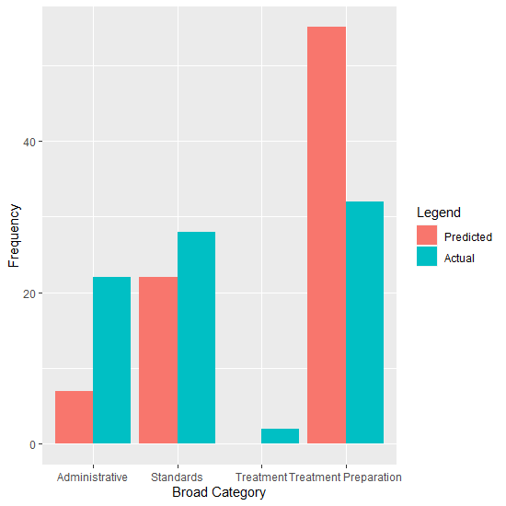
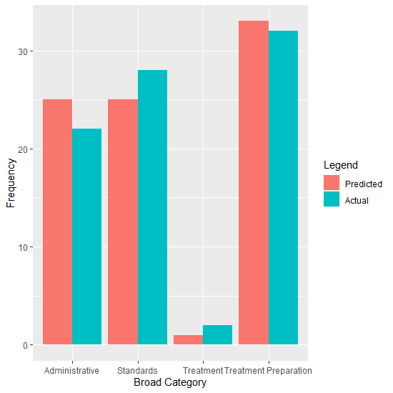
Modeling: Random Forest (Continued)
Model with LSA data
Model without LSA data
Notes:
Jasper

Slide 20

Modeling: Random Forest (Continued)
For these models, some data manipulation was needed for the predictors to be usable in modeling
DateTime: e.g. "2021-12-21 16:11:19"
Converted into seconds and then scaled using training data
IDbyRole: e.g. "AU"
Missing values were replaced with the majority category
Notes:
Jasper

Slide 21
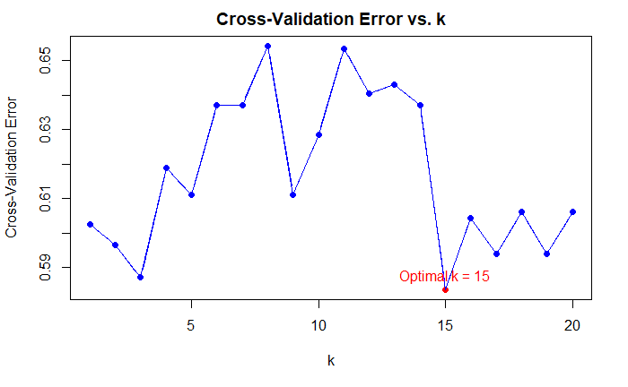
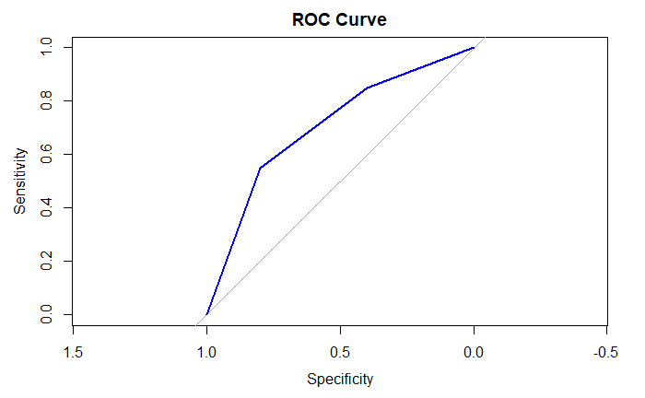
Modeling: k-NN
Text processingᐞ > feature extraction > KNN > cross validation (k=1~20)
ᐞLSA converting the free-text data to a text corpus. (Small sample size made text unit unique. The matrix is sparse all 0s, results in majority singular values).
Response variable: Broad Category (4)
Area under the curve: 0.705
probability model will correctly rank a randomly chosen positive instance higher than a randomly chosen negative instance, with 70.5% accuracy.
Notes:
Next step:

Slide 22
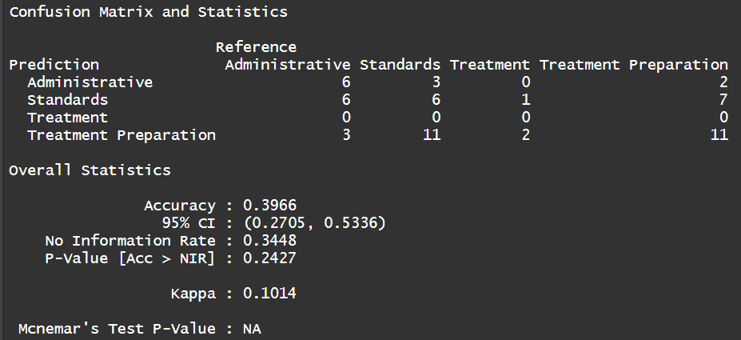
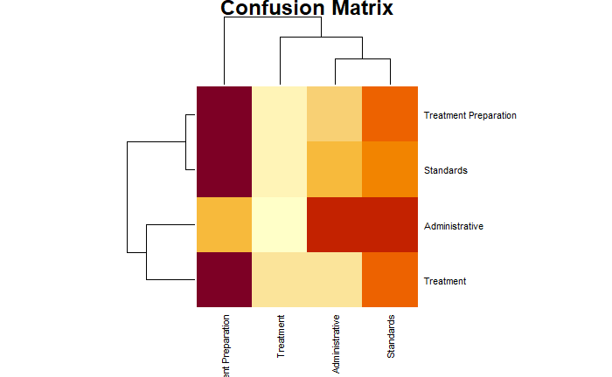
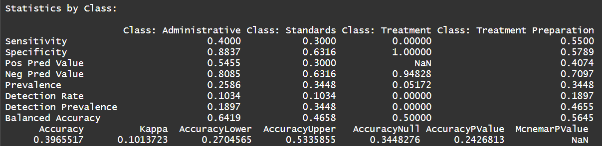
Modeling: k-NN (continued)
Confusion Matrix and Statistics
Number of observations for each combination of true class and predicted class.
For example, there are 6 observations where the true class is 'Administrative' and the predicted class is also 'Administrative'.
Overall Statistics
The proportion of correctly classified instances is 39.66%
Statistics by Class
Kappa = measures agreement between model’s predictions and actual classes
Provided more detailed performance metrics for each class in Broad Category variable
∴ Model improvement and further analysis are needed.

Slide 23


Next Steps
Continue to work on modeling and choose the best one.
Furnish and complete final report
Step 1
Step 2
Step 3
Final step
Go into more detail with LSA (Look at scarcity reduction, etc.)
Explore Neural Networks and see if this provides a better result.
Notes:
Lucy

Slide 24
Sources
Ganguly, I.; Buhrman, G.; Kline, E.; Mun, S.K.; Sengupta, S. Automated Error Labeling in Radiation Oncology via Statistical Natural Language Processing. Diagnostics 2023, 13, 1215. https://doi.org/10.3390/diagnostics13071215
Data provided by: RadPhysics Services LLC

Slide 25
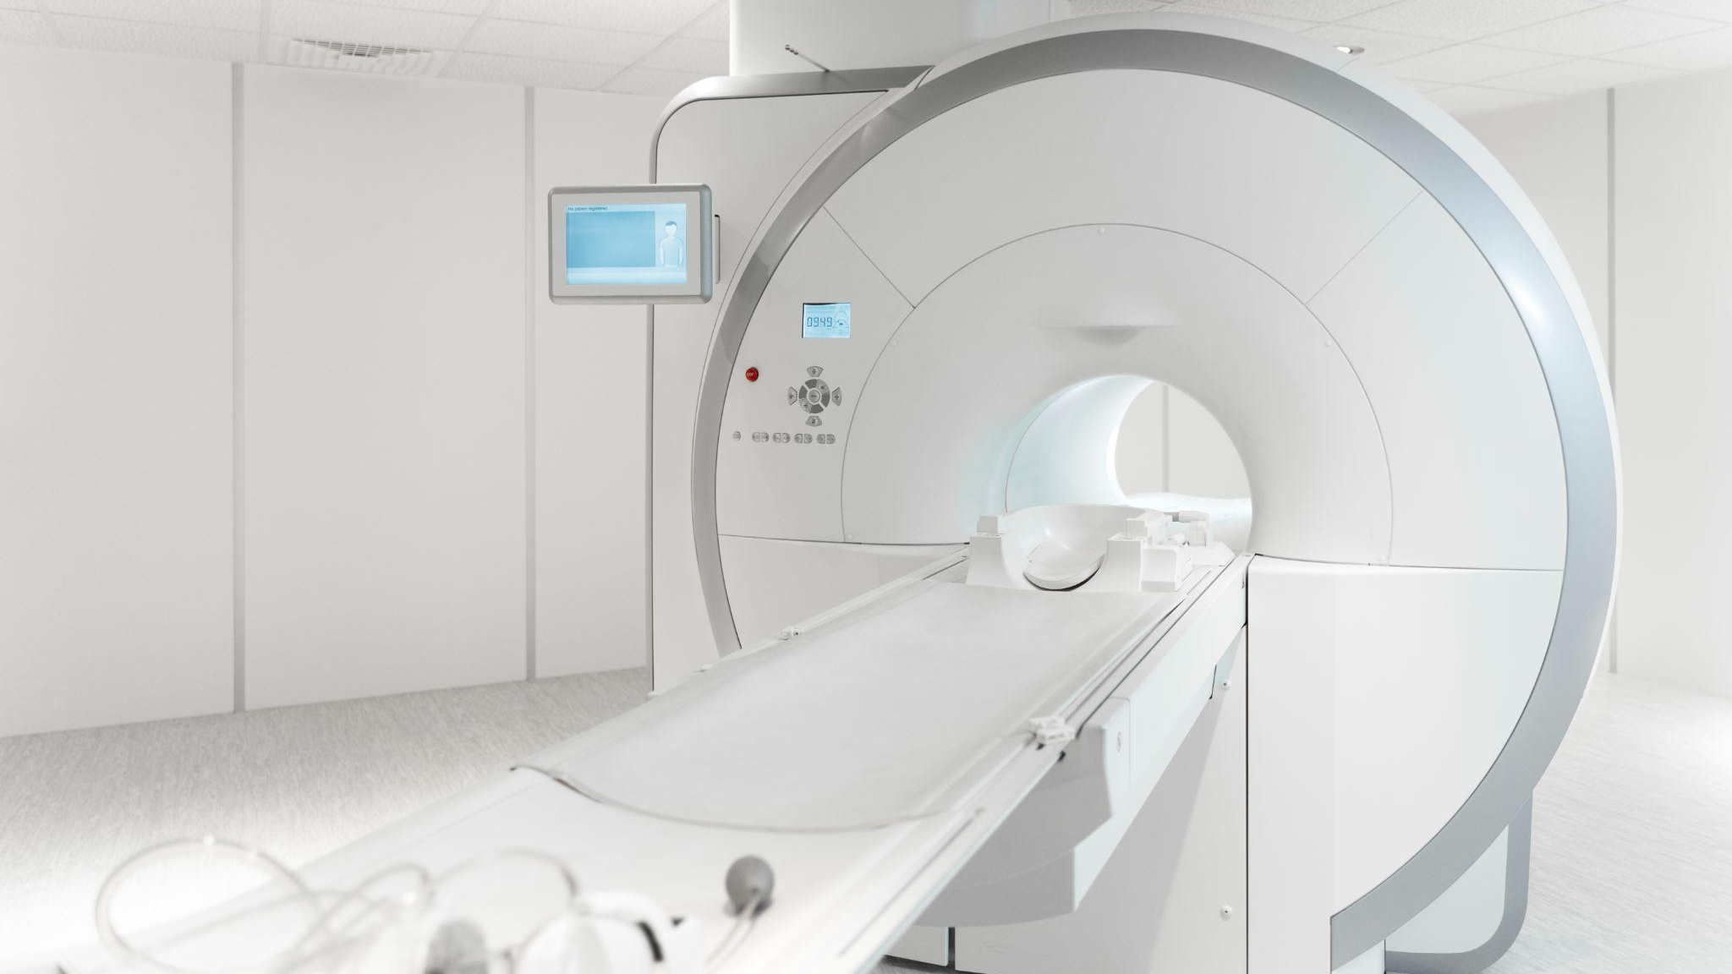
Thank you and questions?

